Slide 1
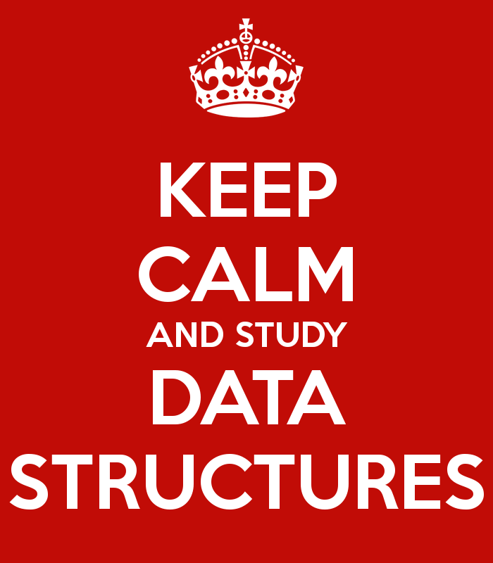
Data Structures
"Bad programmers worry about the code. Good programmers worry about data
structures and their relationships."
- Linus Torvalds

Slide 2
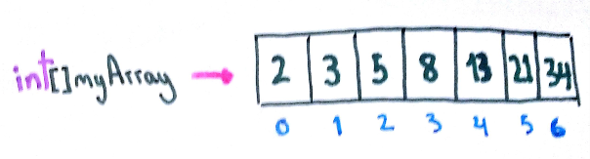
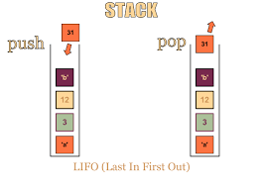
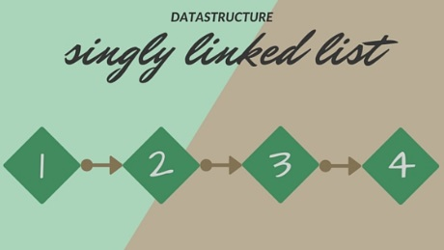
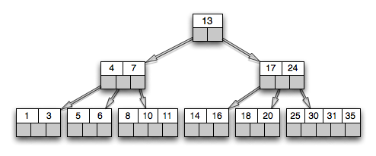
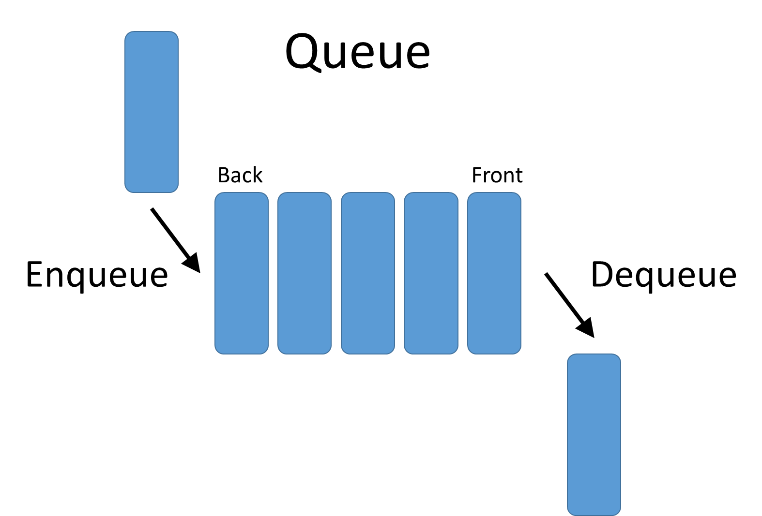
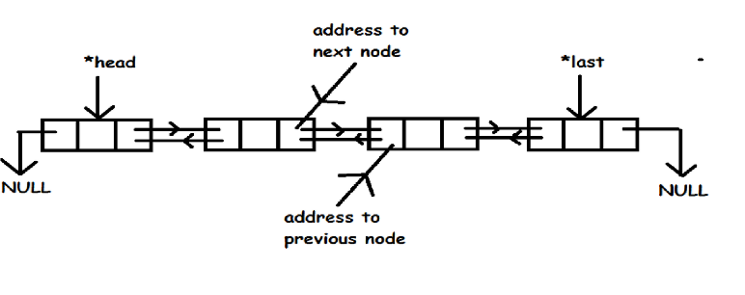
Data Structures
A Data Structure is:
  “an organization of information, usually in computer memory, for better algorithm efficiency."
CS 321 - Data Structures

Slide 3
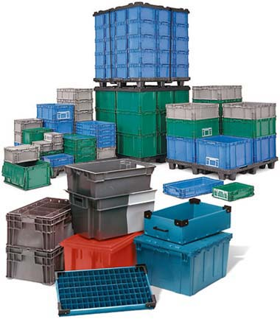
Data Structure Concepts
Data Structures are containers.
  They hold other data.
  Arrays are a data structure.
  So are linked lists.
Other types of data structures:
  stack, queue, tree,
  binary search tree, hash table,
  dictionary or map, heap, priority queue, …
  en.wikipedia.org/wiki/List_of_data_structures
Different types of data structures are optimized for certain types of operations.
CS 321 - Data Structures

Slide 4
Core Operations
Data Structures have three core operations:
  A way to add things.
  A way to remove things.
  A way to access things, without modifying the data structure.
Details depend on the data structure.
  For instance, a Indexed List data structure may need to:
      add data at position in the List.
      access by data by position.
      remove by data by position.
More operations are added depending on what data structure is designed to do.
CS 321 - Data Structures

Slide 5
Types of Data Structures
Data Structures
Implementation-Dependent
Implementation-Independent
Arrays
Linked Structures
Stacks
Queues
Bags
Sets
Indexed Lists
Linked Lists
Trees
CS 321 - Data Structures

Slide 6
Implementation-Dependent Data Structures
Arrays
  Collection of objects stored contiguously in memory.
  Accessed by index.
Linked Structures
  Collection of node objects.
    Store data and reference to one or more other nodes.
  Linked Lists
    Linear collection of nodes.
    Single-linked List – nodes contain references to next node in list.
    Double-Linked List – nodes contain reference to next and previous nodes in list.
  Trees
    Hierarchical structure.
    Nodes reference two or more “children.”

Slide 7
Implementation-Independent Data Structures
Abstract Data Types (ADTs):
  Descriptions of how a data type will work without implementation details.
  Description can be a formal, mathematical description.
  Many Java interfaces are a form of ADTs.
Examples:
  Stack, Queue, Indexed List, Heap, Binary Search Tree, etc.
CS 321 - Data Structures

Slide 8
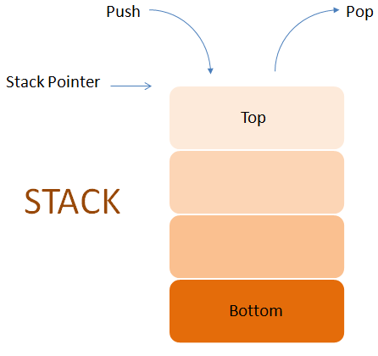
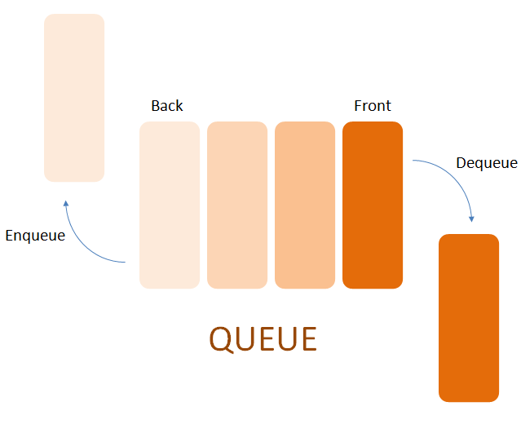
Stack and Queue ADTs
Stack ADT
  Expected behavior: Last in, First out (LIFO)
  Operations: push, pop, peek.
Queue ADT
  Expected behavior: First in, First out (FIFO)
  Operations: enqueue, dequeue, front.
CS 321 - Data Structures

Slide 9
List ADTs
Sorted List
  Items in list are arranged according to “natural ordering.”
  Operations: add, max/min, find, etc.
Indexed List
  Items are accessed by position in list.
  Operations: get, remove(index), add(index), etc.
Unsorted List
  Items are stored without an implicit ordering.
  Operations: addToFront, remove(element), last, etc.
CS 321 - Data Structures

Slide 10
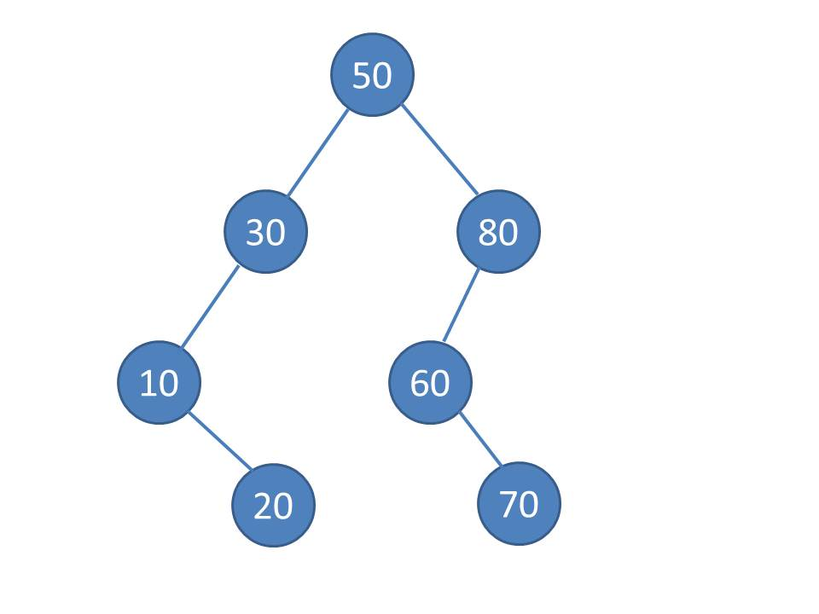
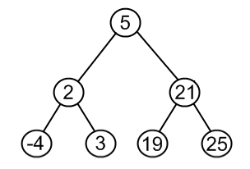
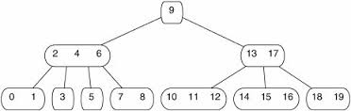
Tree ADTs
Binary Search Trees (BSTs)
  Items stored in sorted order.
Heaps (Max or Min)
  Items stored according to the “Heap Property.”
AVL and Red-Black Trees
  BSTs that stay balanced.
Splay Trees
  BST with most recently items at top.
B-Trees
  Another variation of BST.
  Nodes can have more than two children.
CS 321 - Data Structures

Slide 11
Other ADTs
Priority Queues
  Next item removed has highest / lowest priority.
Hash Tables
  Hash function:
    Computes an index into a table of buckets or slots.
    Look in the bucket for the desired value.
Maps
  Collection of items with a key and associated values.
  Similar to hash tables.
Graphs
  Nodes with unlimited connections between other nodes.
CS 321 - Data Structures

Slide 12
Implementing ADTs
The operations and behaviors are already specified.
  For instance, every Stack has push, pop and peek methods.
  Think Java interface.
But given an interface describing an ADT, how implement it?
  Must decide which internal storage container to use to hold the items in the ADT.
  Usually one of the Implementation-Dependent Data Structures:
    Arrays, Linked Lists, Trees
  But can be another ADT.
    Using Heap to implement a Priority Queue.

Slide 13
ADTs and Data Structures in Programming Languages
Modern programming languages usually have a library of ADTs.
  Java collections framework
  C++ standard template library
  .Net framework (portion of VERY large library)
  Python lists and tuples
  Lisp lists
However, most provided collection classes aren’t pure ADTs.
CS 321 - Data Structures

Slide 14
ADTs in Java
Part of the Java Standard Library is the Collections Framework.
  A library of data structures
  Built on two interfaces
    Collection
    Iterator
  http://java.sun.com/j2se/1.5.0/docs/guide/collections/index.html
CS 321 - Data Structures

Slide 15

CS 321 - Data Structures

Slide 16
Stacks and Queues in the Java Collection API
No queue class in the Java collections API.
  Can implement Queue interface using Java LinkedList class.
Stack extends Vector (which is almost exactly like ArrayList).
  Hmmm?
One reason the Java Collections Library is often said to be broken.
CS 321 - Data Structures

